Slide 1

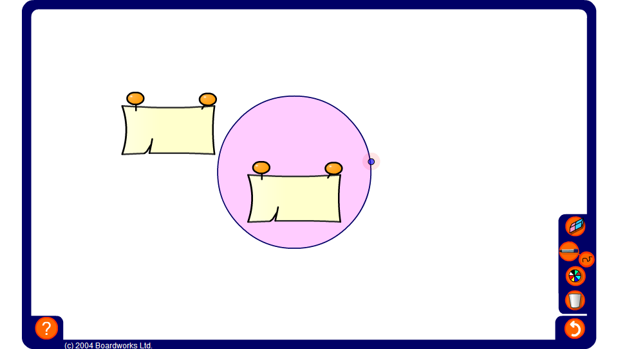


Circle circumference and diameter
Notes:
Drag the circle to different sizes and ask pupils to record the length of the diameter and the circumference for each one. Challenge them to find a link between these two numbers.
Tell pupils that the ratio of the diameter to the circumference of a circle is a fixed amount equal to just over 3. This means that the circumference of a circle is always just over three times the diameter.
Once pupils know the link between the diameter and the circumference, hide the circumference and ask them to find it given the diameter (by multiplying the diameter by 3.14).
Also hide the diameter and ask them how we can find it given the circumference (by dividing by 3.14).

